Slide 1
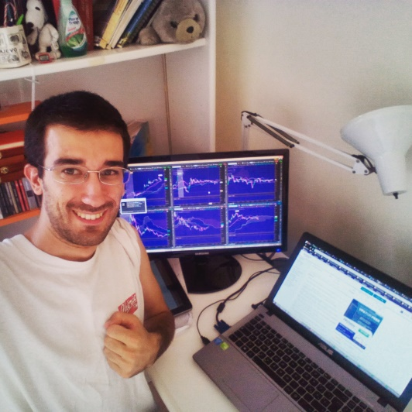
Penny Stocks – The Potential of Trading
Presentation of Roberto La Bella Forex & Penny Stocks Trader
Blog: http://www.besttradingidea.com

Slide 2
Penny Stocks – Complete Lessons
Lesson 1 - Basics about Penny Stocks and why to trade this Market
Lesson 2 - Trading on Penny Stocks, Glossary and Chart Patterns
Lesson 3 - Typical patterns (Pump & Dump...) + live trades examples
Lesson 4 – Brokers Accounts + Tools + Watchlist + Level 2
Lesson 5 - Trading Plan, Money Management and the Rules
Lesson 6 - Most important Trading Charts, Strategy explanation
and application
Lesson 7 - Trading Styles + Advanced Strategies + Thought Process
Lesson 8 - Trading Style, Tips and Tricks, how and what to study!
Lesson 9 - The Power of our own Psychology, Commitment for Success
and Powerful Questions
Lesson 10 - Epilogue and Recap + Daily Work + Exercises + Q&A
Bonus Lessons
Lesson 1 – Live Trades & Morning Session
Lesson 2 – Trades Commentary from different Successful traders
Lesson 3 – Weekly Review and weekly statements
Lesson 4 – Thinking in probabilities (mental approach by Mark Douglas)

Slide 3
Lesson 1 Basics about Penny Stocks and why to trade this Market
- Introduction
- Trading, what is it? Advantages! Why to trade?
- Charts approach and explanation
- Glossary 1
- The Market of Trading and Penny Stocks
- What about wins? + Psychological Approach

Slide 4
What’s the trading in Penny Stocks?
I follow a great Millionaire mentor Timothy Sykes → His live trades

Slide 5
Lesson 2 Trading on Penny Stocks, Glossary and Chart Patterns
Trading on Penny Stocks, what is the edge and carachteristics
Chart explanation 2 and technical approach (volatility/liquidity)
Glossary 2 (market orders,limit orders, moving average,indicators)
Breakouts / Breakdowns / Typical Patterns
Some trades examples & Potential
Home exercises and recap

Slide 6
Lesson 3 Typical patterns (Pump & Dump...) + live trades examples
Glossary 3 – Market Indexes, Brokers, Promoters
Typical schemes and Pump&Dump
SuperNova
Advanced Breakouts + Cup&Handle + Double Bottom/Top
Live Trades Examples
Home exercises and recap

Slide 7
Lesson 4 Brokers Accounts + Tools + Watchlist + Level 2
Brokers for Penny Stocks
How to start and make the first trade!
Tools for stocks Research (Finiviz & Yahoo.com)
Other Tools
Level 2 – basics
Level 2 - examples

Slide 8
Lesson 5 Trading Plan, Money Management and the Rules
Trading Plan
Money Management
Inside the Trading Plan
Strategy and Application
Process to make a trade

Slide 9
Lesson 6 Most important Trading Charts, Strategy explanation and application
Reading Charts
3 Revolutionary Strategies
Buy EW/CW on dip near multi-day/month support
Intraday or late day breakout
Short Sell on early morning over-extended charts
Strategy Application and trades review
Results and statistics

Slide 10
Lesson 7 Trading Styles + Advanced Strategies + Thought Process
Trading Styles, Scalping & Big Picture
How to plan and Thought Process to execute
Advanced Strategies + Charts

Slide 11
Lesson 8 Trading Style, Tips and Tricks, how and what to study!
How to develop your own Trading Style
Kings of the Stock Market ! (Follow Successful Traders)
How and what to Study?
How to go ultra-fast in the learning process?....(!)

Slide 12
Lesson 9 The Power of our own Psychology, Commitment for Success
and Powerful Questions
The right mindset for Trading
Commitment for Success
Psychologial Session and tools
Powerful Questions

Slide 13
Lesson 10 Epilogue and Recap + Daily Work + Exercises + Q&A
Reinforce your Skills
Increase your knowledge and learn technical analysis
Find your Strategy and become an expert
Stretch your Mind and improve your Psychology
Fire your Boss and Focus on Trading

Slide 14
Bonus Lessons
Lesson 1 - Live trades & Morning Session
Lesson 2 - Commentary from different Successful Traders
Lesson 3 - Weekly Review and Weekly Statements
Lesson 4 - Thinking in probabilities (mental approach by Mark Douglas)

Slide 15
Think Big!

